Slide 1

Application: Hearts & Paws Type: Application Architecture View: Logical View Style: Layered Architecture Pattern
Users
Delivery Channels
Core Business Processes
Data And Information
Technology Enablers
Authentication
& Authorization
User Details
Payment Gateways
Profile Management
Pet Data
Google Maps API
Booking Data
Search & Filter Logic
Cloud Services (AWS )
Renters
Web Browser
&
Mobile App
Payment
Payment Confirmation
Email Service
Review Data
Review & Rating
Pricing Information
Github & Delivery Pipeline
Admin
Advertisement Management
Availability Schedules
Database Services

Slide 2
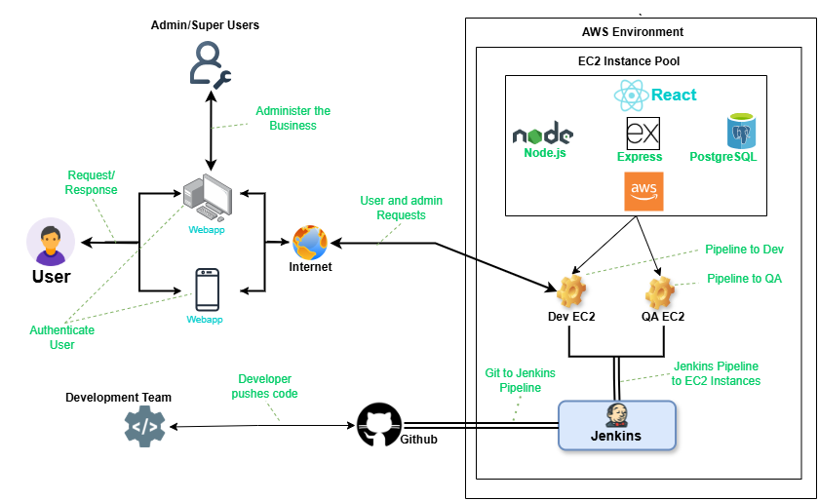
Application: Hearts & Paws Type: Application Architecture View: Process View Style: Client-Server Pattern

